Slide 1
P.O. Box 515429
Dallas, Texas 75075
Ph: (972) 669-3390
Fax: (469) 241-0896
Email: oseicorp@msn.com
Web: www.osei.us
This Presentation will show the Missouri Dominator Truck Stop Under Ground Storage release contaminating Soil and
Ground Water, Under the Pavement Was
Remediated With OSE II
OSE II has been used on Ground Water, as well
as Underground hydrocarbon and Hydro
Carbon Based spills in the US and Globally
Since 1989

Slide 2
Third-Party Performance Testing
US EPA Testing
US EPA & National Environmental Technology Application Center (NETAC)
A 28-day reduction test concluded that OSE-II significantly reduces petroleum mass.
There have been 35 toxicity tests performed on OSE II in numerous countries, on fresh and ocean water species showing an average LC50 or LD 50 of 1900 ppm or above, there are also eco toxicity and endocrine disruptor tests as well. The US EPA set the virtually non toxic level at 100 ppm or above.
See Link http://osei.us/wp-content/uploads/35-toxicity-tests.pdf

Slide 3
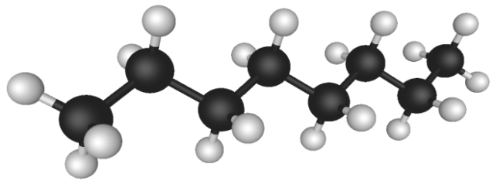
How OSE II Works
Combination of bio-surfactants, enzymes and nutrients
Enables indigenous micro-organisms to efficiently and completely break down contaminant
Leaves only harmless CO2 and water
CO2
H2O
Three-Pronged Attack
Immediately attacks the molecular structure of the hydrocarbons reducing toxicity to micro organisms.
Provides enzymes to act as catalysts increasing metabolic breakdown
Provides nutrients to enhance microbial action
OSE II emulates mother natures own process, except OSE II speeds the process up to reduce hydrocarbons in a matter Of days or weeks in stead of decades, or not all in some scenarios…………….......See
See link http://osei.us/tech-library-pdfs/2011/4-OSEI%20Manual_EmulatingNature.pdf

Slide 4
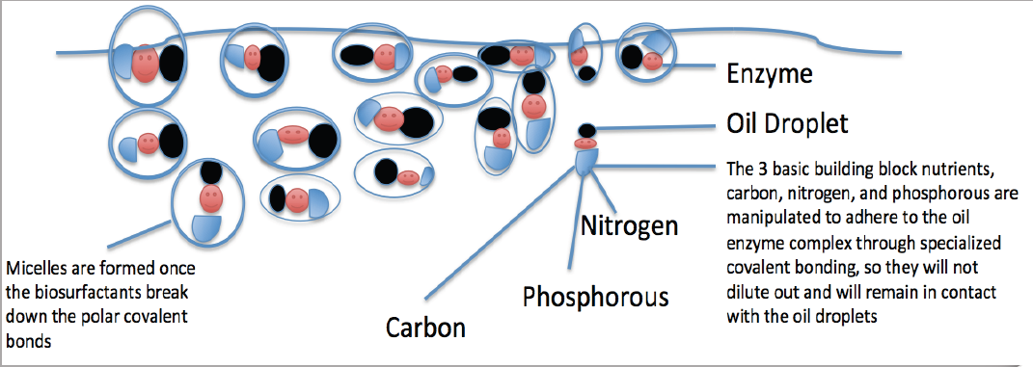
OSE II’s Bio Surfactant Are Produced by a Combination of Plant and Animals
Oil Spill Eater International (OSEI) utilizes bio surfactants as its first mode of
action in the Oil Spill Eater II product. The bio surfactants initiate micelle
formation when introduced into an oil/water environment. Micelles are activated
when mixed with a sufficient amount of water such that each micelle is then
completely surrounded by a thin layer of water molecules. The outside of the
micelle is hydrophilic, meaning it likes water, while the interior portion is
hydrophobic, meaning it avoids water. This provides a way to dissolve
molecules, like fats, oils and grease that do not like water, in water.

Slide 5
Missouri Domminator Truck Stop and Under Ground/Ground Water hydrocarbon Release
US EPA Testing: The US Congress requires the US
EPA to keep a list of products that can be legally
used on US Navigable waters, which is why there is
a list of products on the National Contingency Plan
(NCP) List.
OSE II is listed on the NCP List.
A 28-day mass reduction required by the NCP List
concluded that OSE-II significantly reduces
petroleum mass. See link to US EPA information on OSE II https://www.osei.us/wp-content/uploads/US-EPA-notebook-with-technical-information-on-OSE-II-highlighted-section-vI-1.pdf
OSE II is Listed By The US EPA and is Safe
Tested by US EPA and found to be
completely non-toxic. See link for the 35 Marine Species Toxicity test https://www.osei.us/wp-content/uploads/35-toxicity-tests.pdf
Safe for human, animal, plants and
marine life. See OSHA Letter link https://www.osei.us/tech-library-pdfs/2011/9-OSEI%20Manual_OSHA.pdf
Does not require any special handling or protective equipment.
Can be applied in-situ or ex-situ, depending on the location.

Slide 6
Missouri Dominator Truck Stop and Under Ground/Ground Water hydrocarbon Release
• Site Conceptual Model:
– Active truck and vehicle fueling facility
– 3 Diesel and 2 Gasoline USTs
– Commercial Land Use
– 3 miles east of Missouri River
– 0 – 40 feet Silts with Clay lenses
– 40 – 100 feet fine to coarse Sand
– City of Rock Port public water supply wells 200 feet downgradient
– City wells only 100-110 feet TD
– Detailed core analysis and downhole geophysical logging
confirmed NO confining unit within the upper 100 feet. Surficial
aquifer is 20-125 feet.
– 3 Source Areas – Diesel Pumps, Gas Pumps, Gasoline UST
– TRIAD Approach

Slide 7
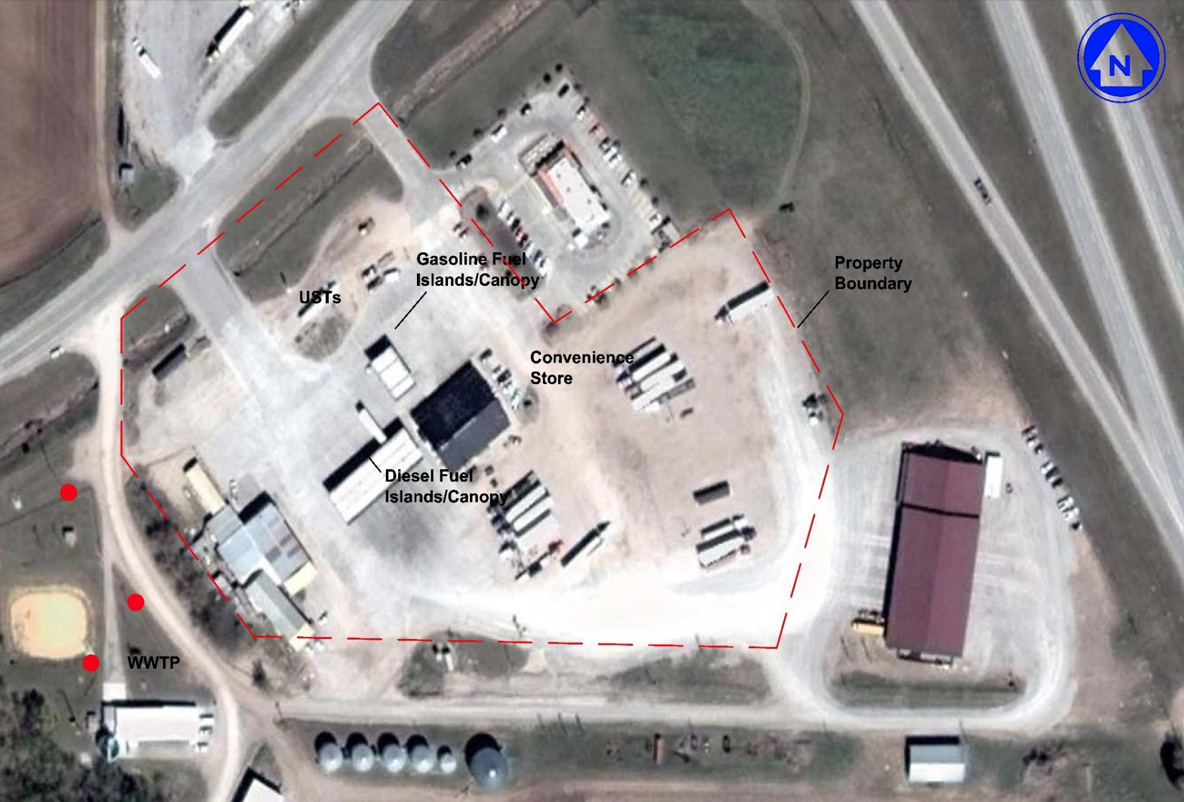
Missouri Dominator Truck Stop and Under Ground/Ground Water hydrocarbon Release
Dominator Fuels Site Map

Slide 8
Missouri Domminator Truck Stop and Under Ground/Ground Water hydrocarbon Release

Slide 9
Missouri Dominator Truck Stop and Under Ground/Ground Water hydrocarbon Release
Predictable Removal Of Free Product
• Follow-up meeting at MDNR was conducted to further discuss the site specific
TPH-DRO target levels to properly demonstrate adequate free product removal
in the diesel dispenser area on site.
• All parties agreed to collect one additional geotechnical sample and a product
sample so that a DRO SSTL in soil could be calculated to demonstrate FP
removal.
• The soil porosity and product density analyses were completed.
• EMR utilized equations by J. Michael Hawthorne, PG to determine the
maximum allowable TPH-DRO concentration in soil that would result in a NAPL
saturation of 10%. The calculations are provided below:
TPH-DRO = (NAPL Saturation) (Porosity) (Product Density)
(Bulk Density) (10-6)
TPH-DRO = (0.10) (0.47) (0.8468g/cm3)
(1.42g/cm3) (10-6)
Site Specific Target Level for TPH-DRO = 28,429 mg/kg

Slide 10
Missouri Dominator Truck Stop and Under Ground/Ground Water hydrocarbon Release
Remedial Action Plan
Remedial Strategy – InSitu Enhanced Bioremediation
• Increase DO with Commercial Blowers
• Increase microbial count and activity by the injection
of Oil Spill Eater II (OSEII).
• Utilized on site
• Aerated OSE II in poly tank prior to addition of
OSEII
• Pressure injection of OSE II track mounted
Geo probe and grout pump.
• Pressure injection of OSEII using Geo probe and
double diaphragm pump.
• Contingent HVE event (FP removal)

Slide 11
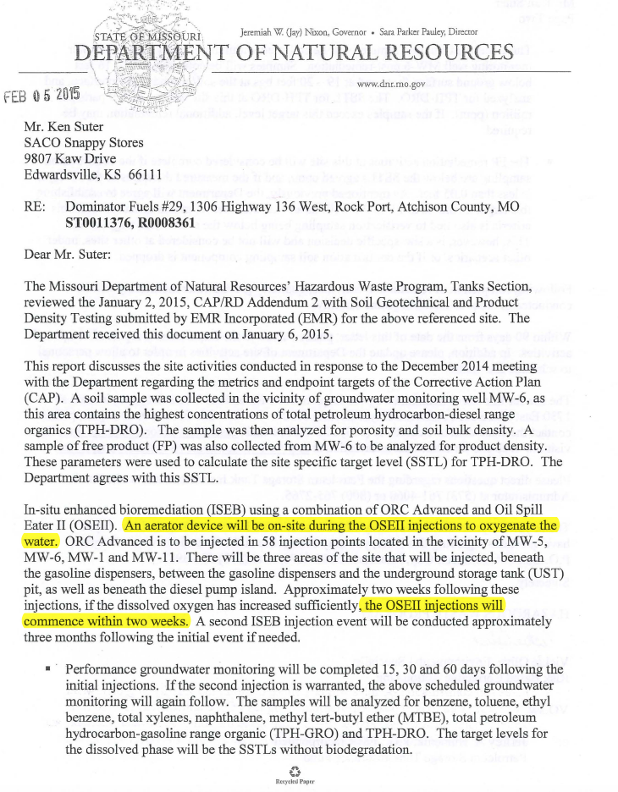
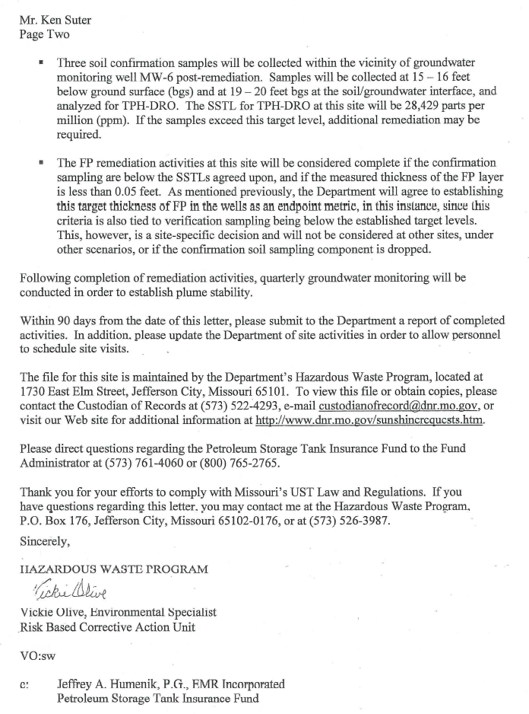
Missouri DNR approving the remedial plan for the Dominator Truck Site With OSE II

Slide 12
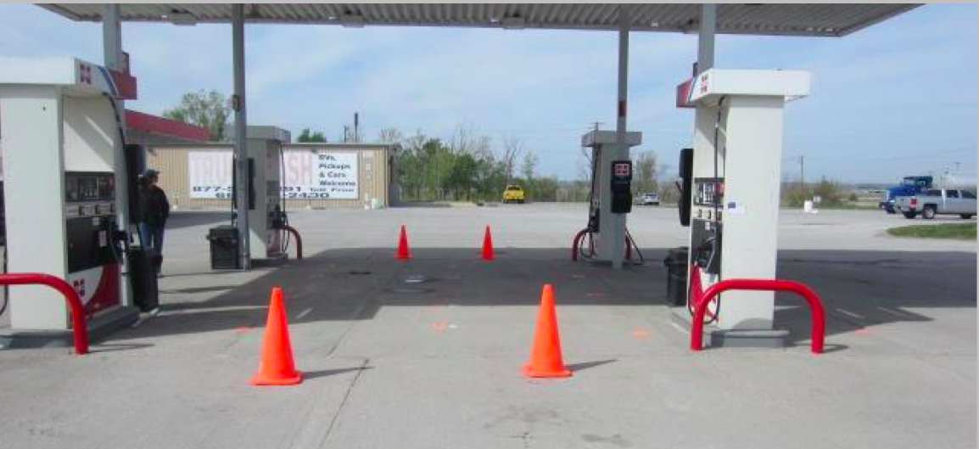
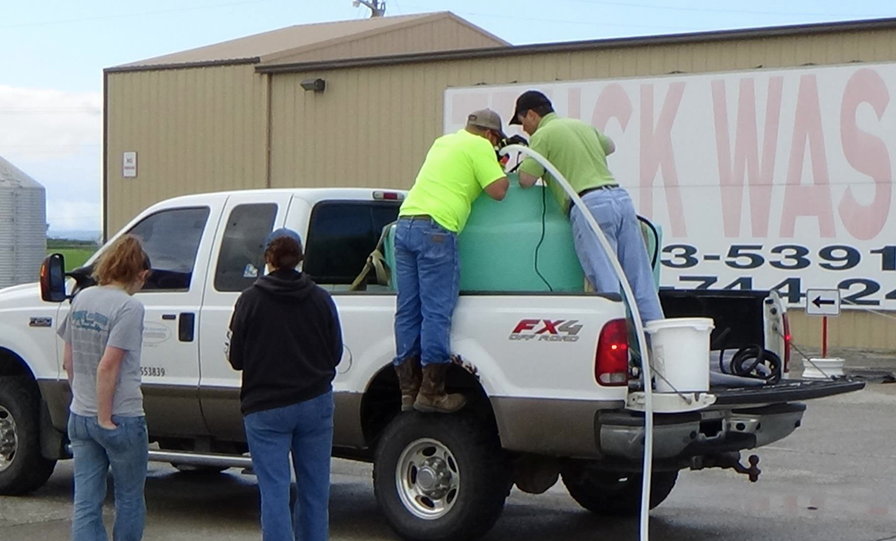
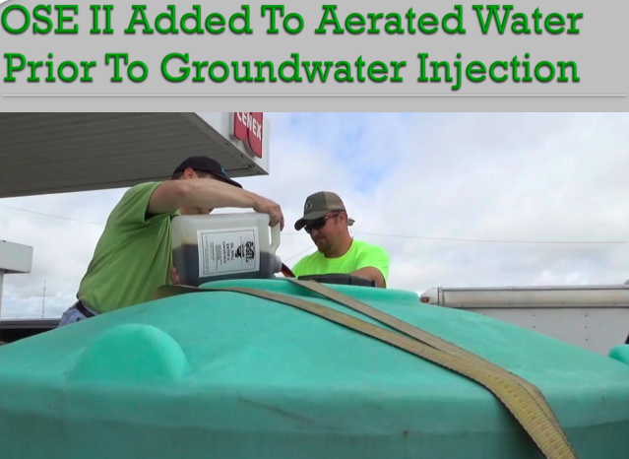
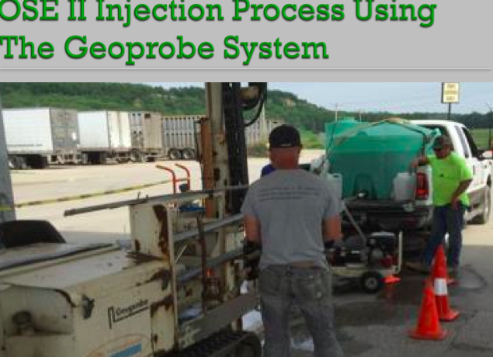
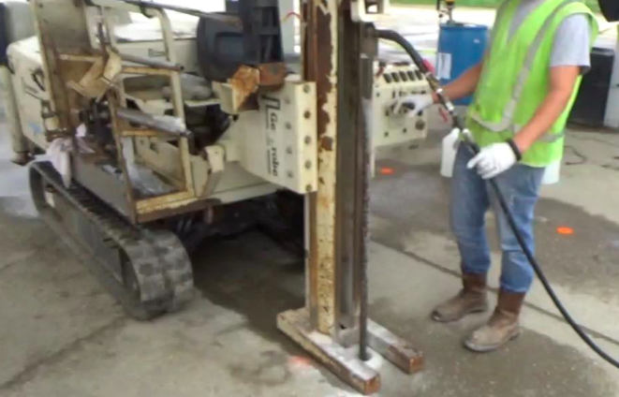
Missouri Dominator Truck Stop Ground Water Injections Of OSE II

Slide 13
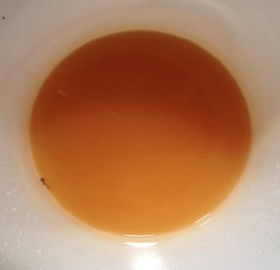
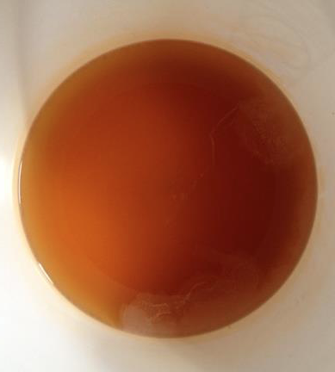
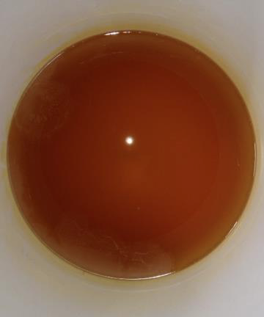
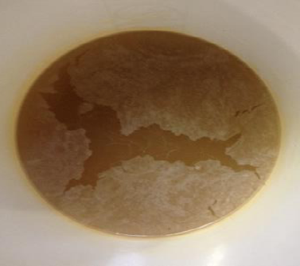
This Presentation will show The Missouri Dominator Truck Stop
Gasoline and diesel fuel Release From Under Ground Storage
Tanks Contaminating Soil and Ground Water
Microbial Plate counts increased dramatically from 42 cfu/ml August 14, 2015 to 142,000,000 cfu/ml on September 15, 2015
Aerobic Heterotrophic Plate Count Results as of Sept 2015
The fact the color of the extracted effluent in the Petri dishes became more turbid with each extraction shows the enormous amount of indigenous bacteria growing, which means the bacteria are digesting the released hydrocarbons to CO2 and water

Slide 14
Missouri Dominator Truck Stop and Under Ground/Ground Water hydrocarbon Release
Test results

Slide 15
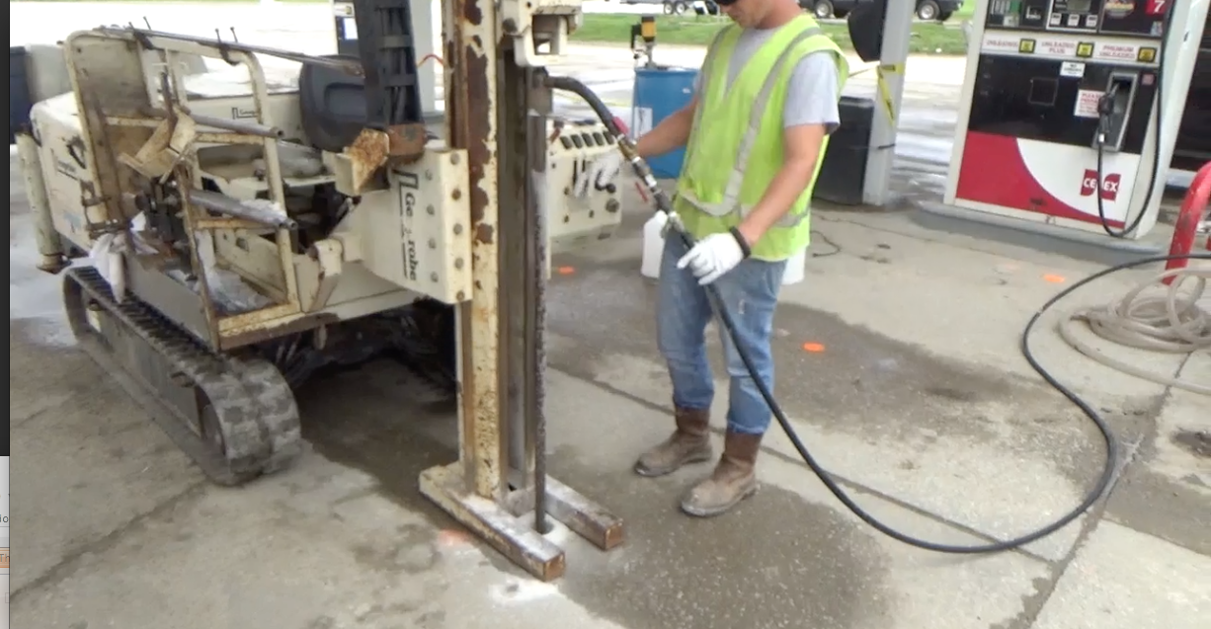
Missouri Dominator Truck Stop and Under Ground/Ground Water hydrocarbon Release
Site Conclusion
The test results were satisfactory to the DNR, where the site was closed a short time later.
OSE II once again showing how capable it is at remediating hydrocarbons even in sensitive
Ground Water
OSE II pumped from the blue drum here
OIL SPILL EATER II protecting the most sensitive environments

