Slide 1

P.O. Box 515429
Dallas, Texas 75075
Ph: (972) 669-3390
Fax: (469) 241-0896
Email: oseicorp@msn.com
Web: www.osei.us
This Presentation will show The Missouri Walnut Hill Grove
Pipeline Break Contaminating Soil and Ground Water, being
remediated with OIL SPILL EATER II ( OSE II)
OSE II has been used on Ground Water, as well
as Underground hydrocarbon and Hydro
Carbon Based spills in the US and Globally
Since 1989

Slide 2
Missouri Walnut Grove pipeline break Contaminating Under Ground/Ground Water
hydrocarbon Release
US EPA Testing: The US Congress requires the US
EPA to keep a list of products that can be legally
used on US Navigable waters, which is why there is
a list of products on the National Contingency Plan
(NCP) List.
OSE II is listed on the NCP List.
A 28-day mass reduction required by the NCP List
concluded that OSE-II significantly reduces
petroleum mass. See link to US EPA information on OSE II https://www.osei.us/wp-content/uploads/US-EPA-notebook-with-technical-information-on-OSE-II-highlighted-section-vI-1.pdf
OSE II is Listed By The US EPA and is Safe
Tested by US EPA and found to be
completely non-toxic. See link for the 35 Marine Species Toxicity test https://www.osei.us/wp-content/uploads/35-toxicity-tests.pdf
Safe for human, animal, plants and
marine life. See OSHA Letter link https://www.osei.us/tech-library-pdfs/2011/9-OSEI%20Manual_OSHA.pdf
Does not require any special handling or protective equipment.
Can be applied in-situ or ex-situ, depending on the location.

Slide 3
OSE II Has A Three Phase Attack
1. Bio surfactants initially attack the molecular structure of the
contaminant. This breaks the oil into small particles [emulsification],
allowing for the break up of the contaminant molecules. This action
simultaneously reduces the toxicity of the oil/fuel, allowing the indigenous
bacteria access to utilize the oil/fuel as their primary food source.
2. Enzymes [over 156] form protein-binding sites to induce the
indigenous bacteria to digest the detoxified oil and convert to CO2 and
water.
3. Nutrients contained in the OSE II formula accelerate the rapid
growth and colonization of larger populations of indigenous bacteria
present at the spill site. When the indigenous bacteria utilize all of the OSE II
nutrients for accelerated growth and colonization, the indigenous bacteria
convert to the only food source left--- the detoxified contaminant, which
subsequently converts to CO2 and water. The bio- remediation process is
completed.

Slide 4
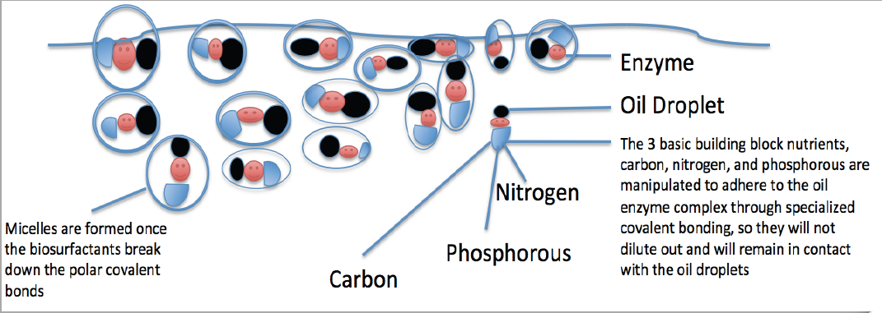
OSE II’s Bio Surfactant Are Produced by a Combination of Plant and Animals
Oil Spill Eater International (OSEI) utilizes bio surfactants as its first mode of
action in the Oil Spill Eater II product. The bio surfactants initiate micelle
formation when introduced into an oil/water environment. Micelles are activated
when mixed with a sufficient amount of water such that each micelle is then
completely surrounded by a thin layer of water molecules. The outside of the
micelle is hydrophilic, meaning it likes water, while the interior portion is
hydrophobic, meaning it avoids water. This provides a way to dissolve
molecules, like fats, oils and grease that do not like water, in water.

Slide 5
Walnut Grove Missouri ground
Water Clean up with OSE II
These slides are from exerpts from the site parameters document for this site.
I. Parameters of contaminated site: Source of information, the OSEI site parameters document filled out by Bob Lanning. Groundwater is regional shallow bedrock aquifer. Residual gasoline, diesel fuel-jet fuel product occurs sporadically at bedrock surface and in bedrock in area 650 ft x 120 ft area. Main bedrock groundwater plume is 1,000 ft x 300 ft in size with some narrow karst connections further (spring is 1,500 ft away), depth is ma 50 ft. The down gradient is North to southwest. There are three seep holes that have been used as application sources.
IV. Procedure:
1. Set up aerators with plastic tubes to inject air into the 3 injection Seep/wells. There should not be air sparging just constant air, and turn on the aerator/aerator’s.
2. Extract the 1100 gallons or an amount close to this amount gallons of water from a nearby fresh water source, creek, river, stream, or lake/reservoir, well with bacteria in the water.
3. Add the 2, 55 gallon drums or 110 gallons of OSE II to the water tank if you are not using an eductor/induction system, and mix thoroughly with paddle.

Slide 6
IV. Procedure:
1. Set up aerators with plastic tubes to inject air into the 3 injection Seep/wells. There
should not be air sparging just constant air, and turn on the aerator/aerator’s.
2. Extract the 1100 gallons or an amount close to this amount gallons of water from
a nearby fresh water source, creek, river, stream, or lake/reservoir, well with bacteria in the water.
3. Add the 2, 55 gallon drums or 110 gallons of OSE II to the water tank if you are not using an eductor/induction system, and mix thoroughly with paddle.
Note half of the required OSE II and water mixture per area will be added on day
One and the other half of the OSE II and water mixture will be added 24 hours later .
.
4. Add 200 gallons of the OSE II and fresh water mixture to each of the three Seep’s/ wells, 1, 2, and 3 for a total volume of 600 gallons Seeps for a second time, the entire contents of the water tank/truck should be emptied into the Seep”s/wells for a
total volume of 600 gallons.

Slide 7
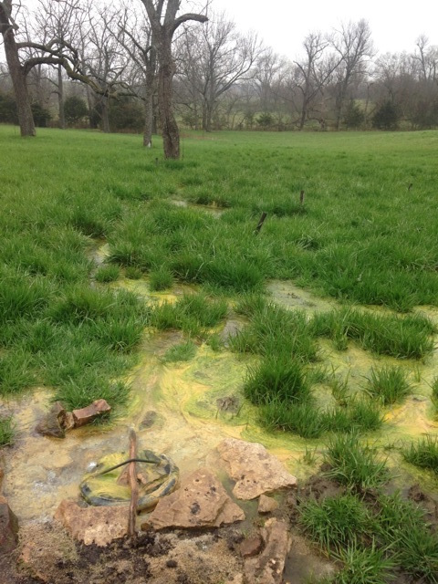

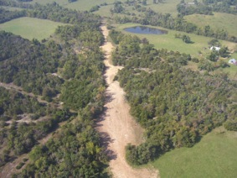
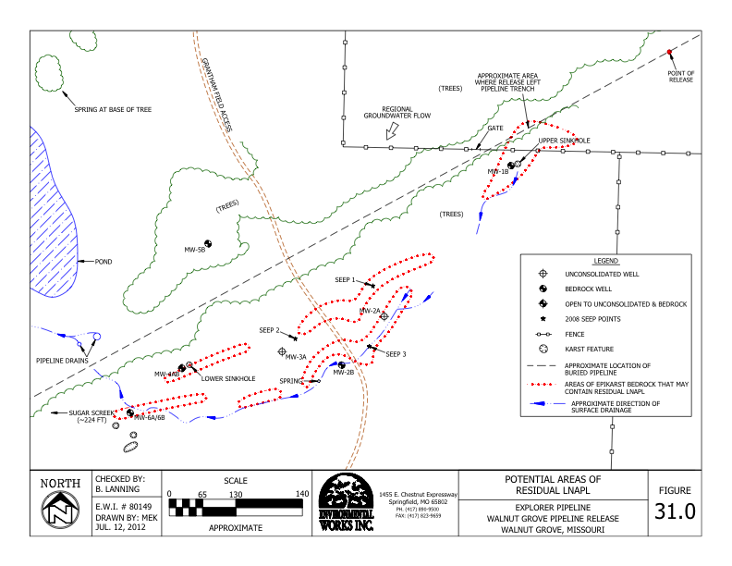
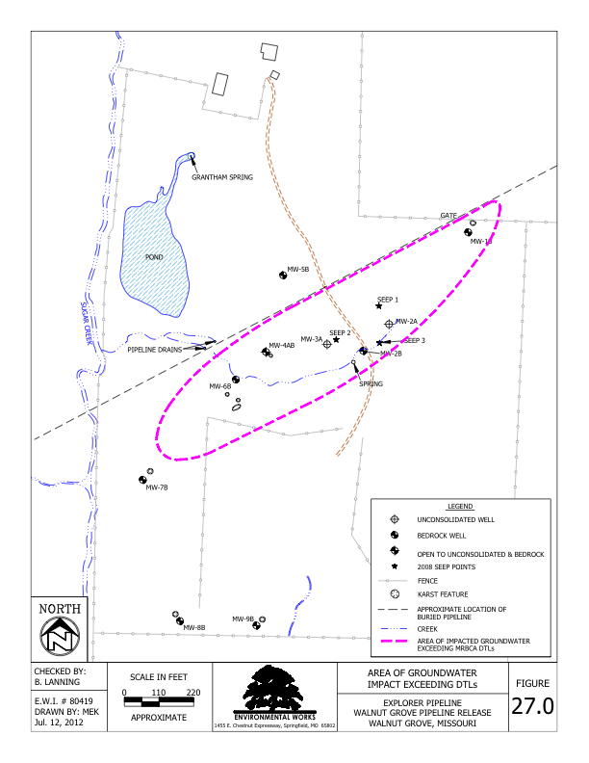
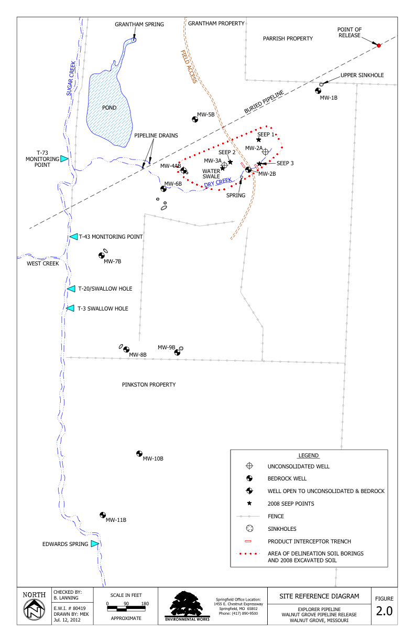
Walnut Hill Grove Pipeline Break and Under Ground/Ground Water Release
Drain established for the pipeline
Pipeline view traversing a down hill gradient where under ground break occurred
Pipeline release covered a large area

Slide 8
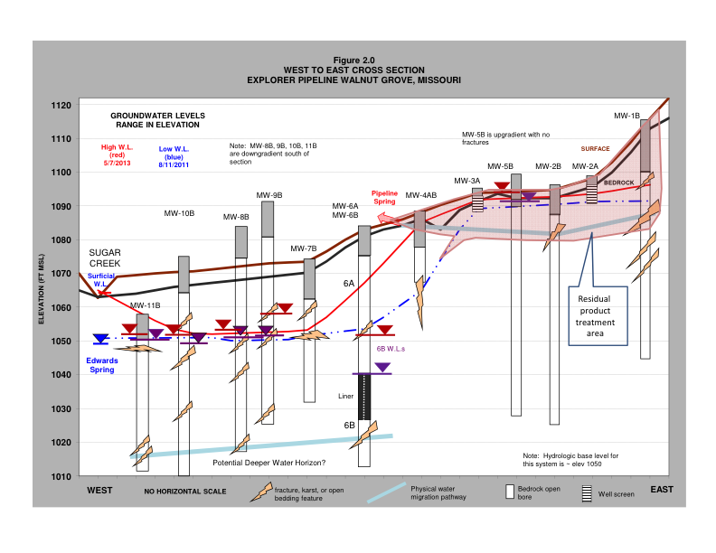
Walnut Hill Grove Pipeline Break and Under Ground/Ground Water Release

Slide 9
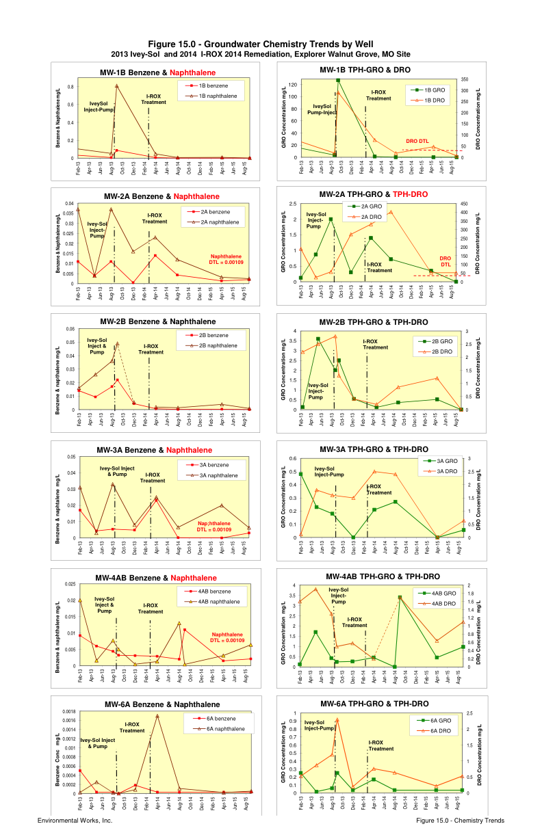
Walnut Hill Grove Pipeline Break and Under Ground Release
Test Results
OSE II reduced the target contaminants below drinking water standards 20 days after application
Missouri DNR closed the site in 45 days after applying OSE II, due to the great results that far exceeded the States standards for ground water clean up

Slide 10
Walnut Hill Grove Pipeline Break and Under Ground/Ground Water Release
OSEI Site Parameter Information Required Questions to Develop Engineered Step By Step Instructions to Address the Site Contamination
Site: Walnut Grove Pipeline, MO
I. Where is the spill/contamination site? Walnut Grove, MO
II. Is the contamination on soil, ground water, below soil surface or above, on fresh/salt/or brackish water, shoreline or solid surface, or container? Residual in small areas of clayey soil, most impact is in secondary porosity in carbonate bedrock
III. If contamination is on soil, what type of soil, and what is the depth of penetration, and has the contaminant reached ground water, and is there any associated water bodies near the site area? Soil is clay with isolated chert nodules, zero to 10 ft deep. Impact is below groundwater level. Small losing surface stream on west side of impact area, has down gradient spring that has been impacted (rare, small blebs of hydrocarbon). Dissolved concentrations in creek are far below action levels.
1. If there are any associated areas of water near the site? Stream above and small surface pond not impacted
a. Is it fresh, salt or brackish, and is the site tidally influenced? Groundwater & pond are fresh
IV. If contamination is on soil and below the surface, what type of soil is in the area, and what is the area contaminated, and is there any associated water bodies near the site area? See answer to III.
1. If there are any associated areas of water near the site?
a. Is it fresh, salt or brackish, and is the site tidally influenced?
Note: If spill area is on rocky surfaces or soil mixed with rocks, please describe the rocks sizes in inches, feet or yards, and or ml, cm, meters? Very thin soil mantle. Bedrock is consolidated limestone with irregular karst surface, and contains sinkholes, zones of fractures, and vertical and horizontal solution voids
V. Is the contamination on a solid surface such as concrete or asphalt? No, all subsurface. Site area is grassy, woodland, pastures (no livestock)
VI. Is the site containing ground water? Yes, bedrock groundwater depths 5 to 20 ft
1. If so do you know the size of the contaminant plume, and the size of the groundwater area or reservoir? Groundwater is regional shallow bedrock aquifer. Residual gasoline, diesel fuel-jet fuel product occurs sporadically at bedrock surface and in bedrock in area 650 ft x 120 ft area . Main bedrock groundwater plume is 1,000 ft x 300 ft in size with some narrow karst connections further (spring is 1,500 ft away), depth is ma 50 ft..
2. Is the ground water contained or moving? Groundwater is moving, southwest flow confined to fractures and karst horizontal and vertical solution features.

Slide 11
Walnut Hill Grove Pipeline Break and Under Ground/Ground Water Release
3. If the reservoir is not contained what is the speed it is moving, feet per second, miles per hour, distance in 24 hours, meters per second or kilometers per hour?
Bedrock hydro conductivity = 1 to 420 ft/day, overall hydro gradient is 0.015 ft/ft, groundwater flow is variable pending secondary porosity permeability 15 to 2,500+ ft/day, verified by dye tracing.
4. 4. What is the porosity of the soil? Clay soil with very low porosity. Greatest “soil” porosity/permeability is at soil-bedrock interface and solutioned bedding plane voids in upper few feet of bedrock. Bedrock porosity very low outside secondary porosity features.
VII. Fresh water, if the spill is on fresh water is it on a lake, river, stream pond, or Aquifer.
1. Is the spill contained or is it moving. No spill, this was slow release from pipeline leak over unknown timeframe, discovered in 2008. 200 gallons of petroleum product recovered, believe only pockets of residual product remains that can be limited mobilized during heavy rainstorms.
2. If moving, what speed, feet per second, miles per hour, distance in 24 hours, meters per second or kilometers per hour? LNAPL movement not measured; groundwater flow during heavy rains can be very fast (16 ft/minute, dye trace) over short distances.
3. If spill is on a moving body of water, have any barriers been put in place? N/A
4. Does salt water back up into the creek, stream, or river, if so for what period or is it constant in a 24 hour period? N/A
VIII. Aquifer: Is it fresh or salt water? Fresh water
1. What speed does the water move, feet per second, miles per hour, 15 to 2,500+ ft/day in karst features
2. Distance in 24 hours, meters per second or kilometers per hour?
3. Is the spill floating or has it settled to the bottom? Source is petroleum product so is a floater with associated impacted groundwater
4. Has the plume of contaminant been model/size determined? Yes, fully delineated
IX. Salt water: Is the spill on a closed bay, open ocean, intertidal zone, etc.? N/A
1. If in a bay, is there a danger of fire destroying man made property?
2. Does the bay flush very little, somewhat, or completely?
3. Are there any fresh water creeks, rivers, or streams feeding into the bay?
4. If so how many?
5. Open Ocean: Is the spill moving towards land or out to the open ocean?
6. Are there any man made structures, or islands in the path of the spill?
7. Have booms been put in place and if so are they controlling the spills movement?
X. Intertidal Zone: Marsh or Estuary N/A
1. Is the spill contaminating the shoreline?

Slide 12
Walnut Hill Grove Pipeline Break and Under Ground/Ground Water Release
2. Is the shoreline sand, soil, rock or man made/or multiple types, denote each if more than one?
3. What is the tide level, inches, feet/cm meters?
XII. Storage container: Refined, unrefined, or petrochemical. 385 gal recovered product tank onsite. No leaks from here.
1. What is the size of the storage container? 385-gal tank
2. What is the storage container made of? HDPE, double contained
3. Are there vents, or openings that allow access to all areas of the container? Yes, ports
4. What was stored in the container? Recovered petroleum product (200 gal to date)
5. Is there sludge in the container, if so what would be the depth of the sludge? N/A
6. How long has it been since the container was last cleaned out never cleaned (6 yrs)
XIII. In all cases
1. What is the volume of the spill, or the length X width X depth? Unknown. Pipeline leak in underground trench on bedrock, flowed to bedrock fractures, entered karst system, upwelling seeps of product 500 ft downgreadient
2. What type of contaminant has been spilled? Gasoline, diesel fuel, jet fuel mix. Chemicals of concern are benzene, naphthalene, gasoline and diesel range organics. Naphthalene, minor benzene are only remaining chemicals exceeding cleanup standards.
3. How long has the spill been in place? Discovered 2008 (7.5 yrs), pipe repaired, downgradient impacted soil excavated and filled. Some re-impact from stormwater recharge.
4. What type of water, fresh-lake, river, stream, pond or well, brackish, or salt water is nearby if none of these are available, is tap water nearby? Pond water is available; requires owner permission
5. Does the area have 4 seasons, if so what is the ambient average air temperature, for each? Four seasons: summer summer 80 degF, Fall 65 degF, Winter 32 degF, Spring 60 degF
6. How much rain does the area get a year? 45 inches
XIV. Are there any special areas that need protecting? Yes, downgradient offsite spring.
1. Water intakes? No. Area is entirely rural
2. Species that may reside in the area? N/A
3. Structures, man made or naturally occurring? Pond is man-made. Sinkholes, springs, subsurface fracture and karst zone – focal point of impacted groundwater movement.

Slide 13
Walnut Hill Grove Pipeline Break and Under Ground/Ground Water Release
4. Any special circumstances that we need to be made aware of? Property owner very particular about how his land is treated; wife very sensitive to odors. State regulatory agency (MDNR) has lead and must approve all investigation and remediation actions. We have done injections in up-gradient sinkholes (Nov 2011, March 2012), installed Waterloo oxygen diffusers in three wells in August 2012, injection in up-gradient sinkhole with pumping of down-gradient product well in August 2013, injections of OSE II in up-gradient sinkhole and down gradient Geo probe injection grid in seep area. In June 2015 we started to see change in existing microbial growth in wells and at down gradient pipeline drain from rust-colored Fe- and SO4-reducing anaerobic bioremedial to yellow-grey aerobic and oxidizing facultative microbes (per Microbial Insights census analyses). In late 2014 & through last year have done some OSE II injections to feed the microbes. Have seen significant groundwater quality improvement since injections and particularly since OSE II treatment. Naphthalene concentrations are better reaching cleanup goals. What we want to cleanup groundwater quality.
XV. We would appreciate it if we could receive any pictures or videos of the site. Maps/air photo of area and
OIL SPILL EATER II protecting the most sensitive environments

