Slide 1
P.O. Box 515429
Dallas, Texas 75075
Ph: (972) 669-3390
Fax: (469) 241-0896
Email: oseicorp@msn.com
Web: www.osei.us
This Presentation Will Show The Montana Malmstrom Air Force Base, And The US Missile Defense bases in Montana,
Ground Water Contamination From Base Operations,
Was Remediated With OSE II
OSE II has been used on Ground Water, as well
as Underground hydrocarbon and Hydro
Carbon Based spills in the US and Globally
Since 1989

Slide 2
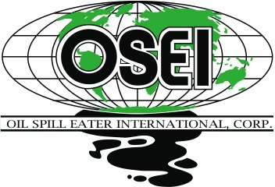
Third-Party Performance Testing
US EPA Testing
US EPA & National Environmental Technology Application Center (NETAC)
A 28-day reduction test concluded that OSE-II significantly reduces petroleum mass.
There have been 35 toxicity tests performed on OSE II in numerous countries, on fresh and ocean water species showing an average LC50 or LD 50 of 1900 ppm or above, there are also eco toxicity and endocrine disruptor tests as well. The US EPA set the virtually non toxic level at 100 ppm or above.
See Link http://osei.us/wp-content/uploads/35-toxicity-tests.pdf

Slide 3
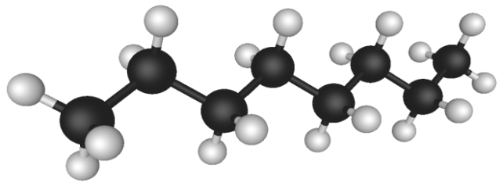
How OSE II Works
Combination of bio-surfactants, enzymes and nutrients
Enables indigenous micro-organisms to efficiently and completely break down contaminant
Leaves only harmless CO2 and water
CO2
H2O
Three-Pronged Attack
Immediately attacks the molecular structure of the hydrocarbons reducing toxicity to micro organisms.
Provides enzymes to act as catalysts increasing metabolic breakdown
Provides nutrients to enhance microbial action
OSE II emulates mother natures own process, except OSE II speeds the process up to reduce hydrocarbons in a matter Of days or weeks in stead of decades, or not all in some scenarios…………….......See
See link http://osei.us/tech-library-pdfs/2011/4-OSEI%20Manual_EmulatingNature.pdf

Slide 4
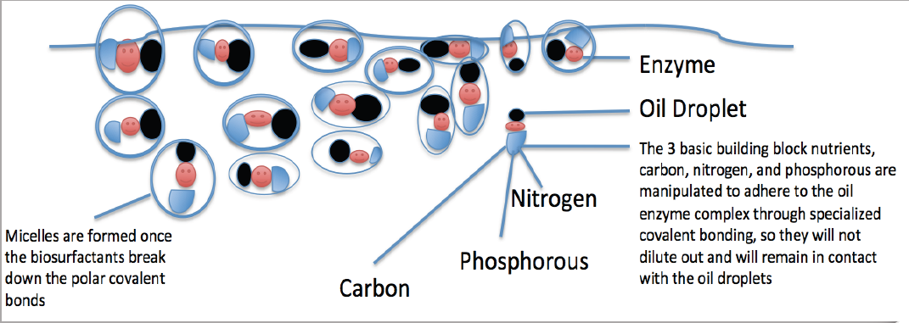
OSE II’s Bio Surfactant Are Produced by a Combination of Plant and Animals
Oil Spill Eater International (OSEI) utilizes bio surfactants as its first mode of
action in the Oil Spill Eater II product. The bio surfactants initiate micelle
formation when introduced into an oil/water environment. Micelles are activated
when mixed with a sufficient amount of water such that each micelle is then
completely surrounded by a thin layer of water molecules. The outside of the
micelle is hydrophilic, meaning it likes water, while the interior portion is
hydrophobic, meaning it avoids water. This provides a way to dissolve
molecules, like fats, oils and grease that do not like water, in water.

Slide 5
The Montana Malmstrom Air Force Base, And the US Missile Defense bases in Montana,
Ground Water Contamination from hydrocarbon Releases
US EPA Testing: The US Congress requires the US
EPA to keep a list of products that can be legally
used on US Navigable waters, which is why there is
a list of products on the National Contingency Plan
(NCP) List.
OSE II is listed on the NCP List.
A 28-day mass reduction required by the NCP List
concluded that OSE-II significantly reduces
petroleum mass. See link to US EPA information on OSE II https://www.osei.us/wp-content/uploads/US-EPA-notebook-with-technical-information-on-OSE-II-highlighted-section-vI-1.pdf
OSE II is Listed By The US EPA and is Safe
Tested by US EPA and found to be
completely non-toxic. See link for the 35 Marine Species Toxicity test https://www.osei.us/wp-content/uploads/35-toxicity-tests.pdf
Safe for human, animal, plants and
marine life. See OSHA Letter link https://www.osei.us/tech-library-pdfs/2011/9-OSEI%20Manual_OSHA.pdf
Does not require any special handling or protective equipment.
Can be applied in-situ or ex-situ, depending on the location.

Slide 6
US AIR FORCE
• Air Force PBR Contracting – 2009
– Worldwide Environmental Restoration and Construction (WERC) 09is a five-year indefinite delivery/indefinite quantity contract. This contract is primarily to provide performance-based environmental and construction services at U.S. Air Force installations worldwide. The contract ceiling of $3 billion is shared by 20 awardees.
• Beginning in 2011 the Air Force Civil Engineer Center
(AFCEC) began to release task order RFPs to awardees
• Prior to the policy change, cleanup efforts focused on achieving remedies in place and individual site remediation, practices that provided only partial cleanup solutions and often required years of expensive follow-up before the property could be returned to unrestricted use.
• “We want to conduct complete cleanups where it is technically feasible and cost effective, and free up these properties to productive private or military uses. It's good for the environment, good for the landowner and
good for the taxpayer.“
"We want to conduct complete cleanups where it is technically feasible
and cost effective, and free up these properties to productive private or military uses. It's good for the environment, good for the landowner and good for the taxpayer.“
• "Successes from these awards show that the new PBR approaches are working to increase the number of site completions where no additional investment of time or money is required by the Air Force, which then leads to the goal of reducing long-term environmental liabilities."

Slide 7
Malmstrom Air Force Base and Missile Defense Types Of Sites And Treatment
• Types of Sites:
– UST (on base and at Missile Alert Facilities)
– OWS
– Fire Training Areas
– Spill Sites (petroleum, chlorinated solvents, PCBs, metals)
– Landfills
• Remedial Strategies:
– Source Removal
– ISEB & ISCO
– Preferred Treatment Enzymatic Bioremediation

Slide 8
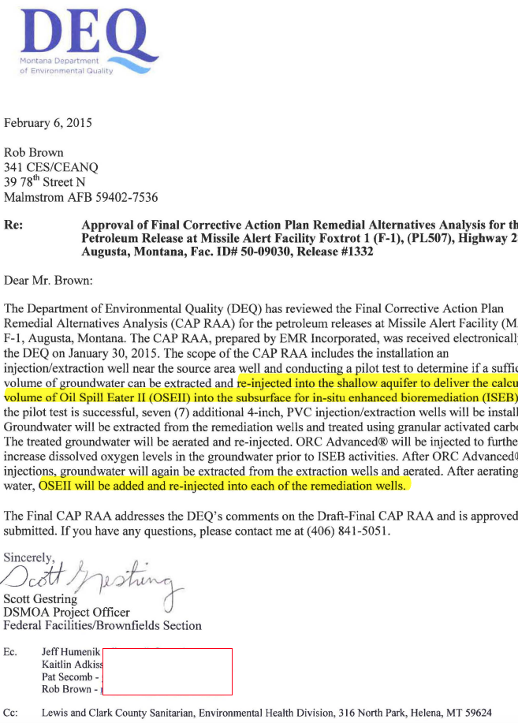
Montana DEQ approves the remedial plans to Inject and Utilize OSE II for Malmstrom Air Force Base, and the US Missile Defense bases in Montana

Slide 9
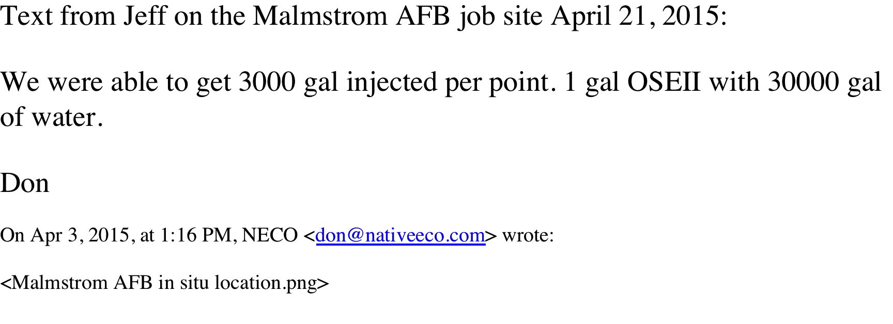
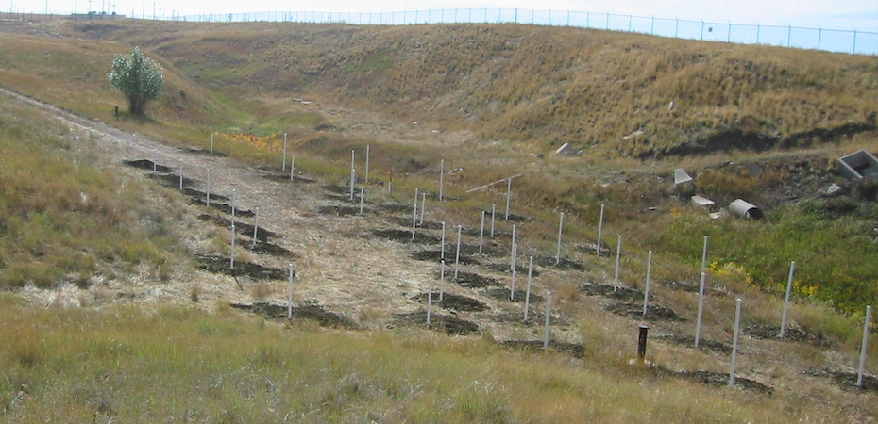
Malmstrom Air Force Base and Missile Defense Application Of OSE II
Steven,
This photo is on the official Malmstrom AFB site with the message that it is the in situ project there. Thought you would be interested to see it.
The final results were well below standards established by the State of Montana, and a closure was signed off on.
Don
OSE II Remediating the most sensitive environments, returning them to pre spill conditions

