Slide 1
P.O. Box 515429
Dallas, Texas 75075
Ph: (972) 669-3390
Fax: (469) 241-0896
Email: oseicorp@msn.com
Web: www.osei.us
This Presentation will show How The Oslo Norway Volvo Service Center Under Ground Storage release of Waste Oil contaminated Soil and Ground Water, As Was the river where the hydrocarbons flowed down
Was Remediated With OSE II
OSE II has been used on Ground Water, as well
as Underground hydrocarbon and Hydro
Carbon Based spills in the US and Globally
Since 1989

Slide 2
Third-Party Performance Testing
US EPA Testing
US EPA & National Environmental Technology Application Center (NETAC)
A 28-day reduction test concluded that OSE-II significantly reduces petroleum mass.
There have been 35 toxicity tests performed on OSE II in numerous countries, on fresh and ocean water species showing an average LC50 or LD 50 of 1900 ppm or above, there are also eco toxicity and endocrine disruptor tests as well. The US EPA set the virtually non toxic level at 100 ppm or above.
See Link http://osei.us/wp-content/uploads/35-toxicity-tests.pdf

Slide 3
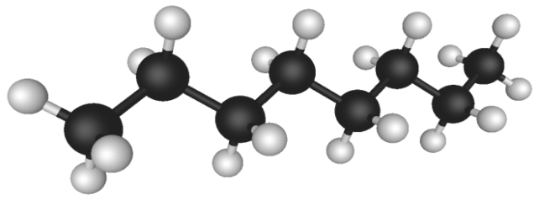
How OSE II Works
Combination of bio-surfactants, enzymes and nutrients
Enables indigenous micro-organisms to efficiently and completely break down contaminant
Leaves only harmless CO2 and water
CO2
H2O
Three-Pronged Attack
Immediately attacks the molecular structure of the hydrocarbons reducing toxicity to micro organisms.
Provides enzymes to act as catalysts increasing metabolic breakdown
Provides nutrients to enhance microbial action
OSE II emulates mother natures own process, except OSE II speeds the process up to reduce hydrocarbons in a matter Of days or weeks in stead of decades, or not all in some scenarios…………….......See
See link http://osei.us/tech-library-pdfs/2011/4-OSEI%20Manual_EmulatingNature.pdf

Slide 4
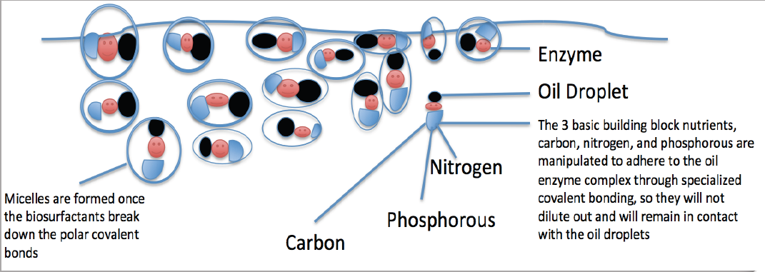
OSE II’s Bio Surfactant Are Produced by a Combination of Plant and Animals
Oil Spill Eater International (OSEI) utilizes bio surfactants as its first mode of
action in the Oil Spill Eater II product. The bio surfactants initiate micelle
formation when introduced into an oil/water environment. Micelles are activated
when mixed with a sufficient amount of water such that each micelle is then
completely surrounded by a thin layer of water molecules. The outside of the
micelle is hydrophilic, meaning it likes water, while the interior portion is
hydrophobic, meaning it avoids water. This provides a way to dissolve
molecules, like fats, oils and grease that do not like water, in water.

Slide 5
Oslo Norway Volvo Service Center Waste Oil Underground Clean Up With Oil Spill Eater II ( OSE II )
OSE II is Listed By The US EPA and is Safe
US EPA Testing: The US Congress requires the US
EPA to keep a list of products that can be legally
used on US Navigable waters, which is why there is
a list of products on the National Contingency Plan
(NCP) List.
OSE II is listed on the NCP List.
A 28-day mass reduction required by the NCP List
concluded that OSE-II significantly reduces
petroleum mass. See link to US EPA information on OSE II https://www.osei.us/wp-content/uploads/US-EPA-notebook-with-technical-information-on-OSE-II-highlighted-section-vI-1.pdf
Tested by US EPA and found to be
completely non-toxic. See link for the 35 Marine Species Toxicity test https://www.osei.us/wp-content/uploads/35-toxicity-tests.pdf
Safe for human, animal, plants and
marine life. See OSHA Letter link https://www.osei.us/tech-library-pdfs/2011/9-OSEI%20Manual_OSHA.pdf
Does not require any special handling or protective equipment.
Can be applied in-situ or ex-situ, depending on the location.

Slide 6
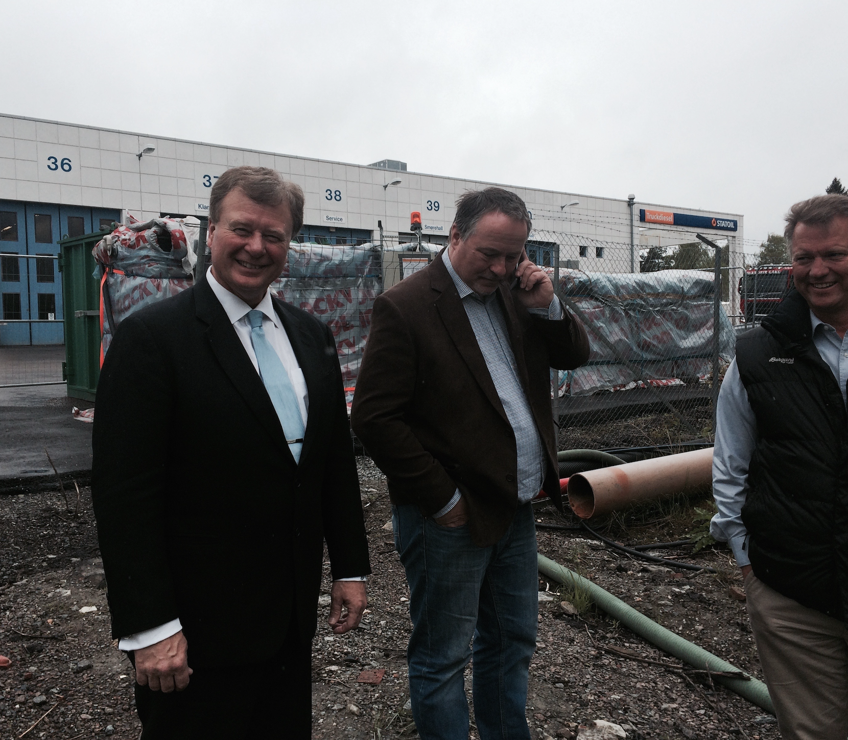
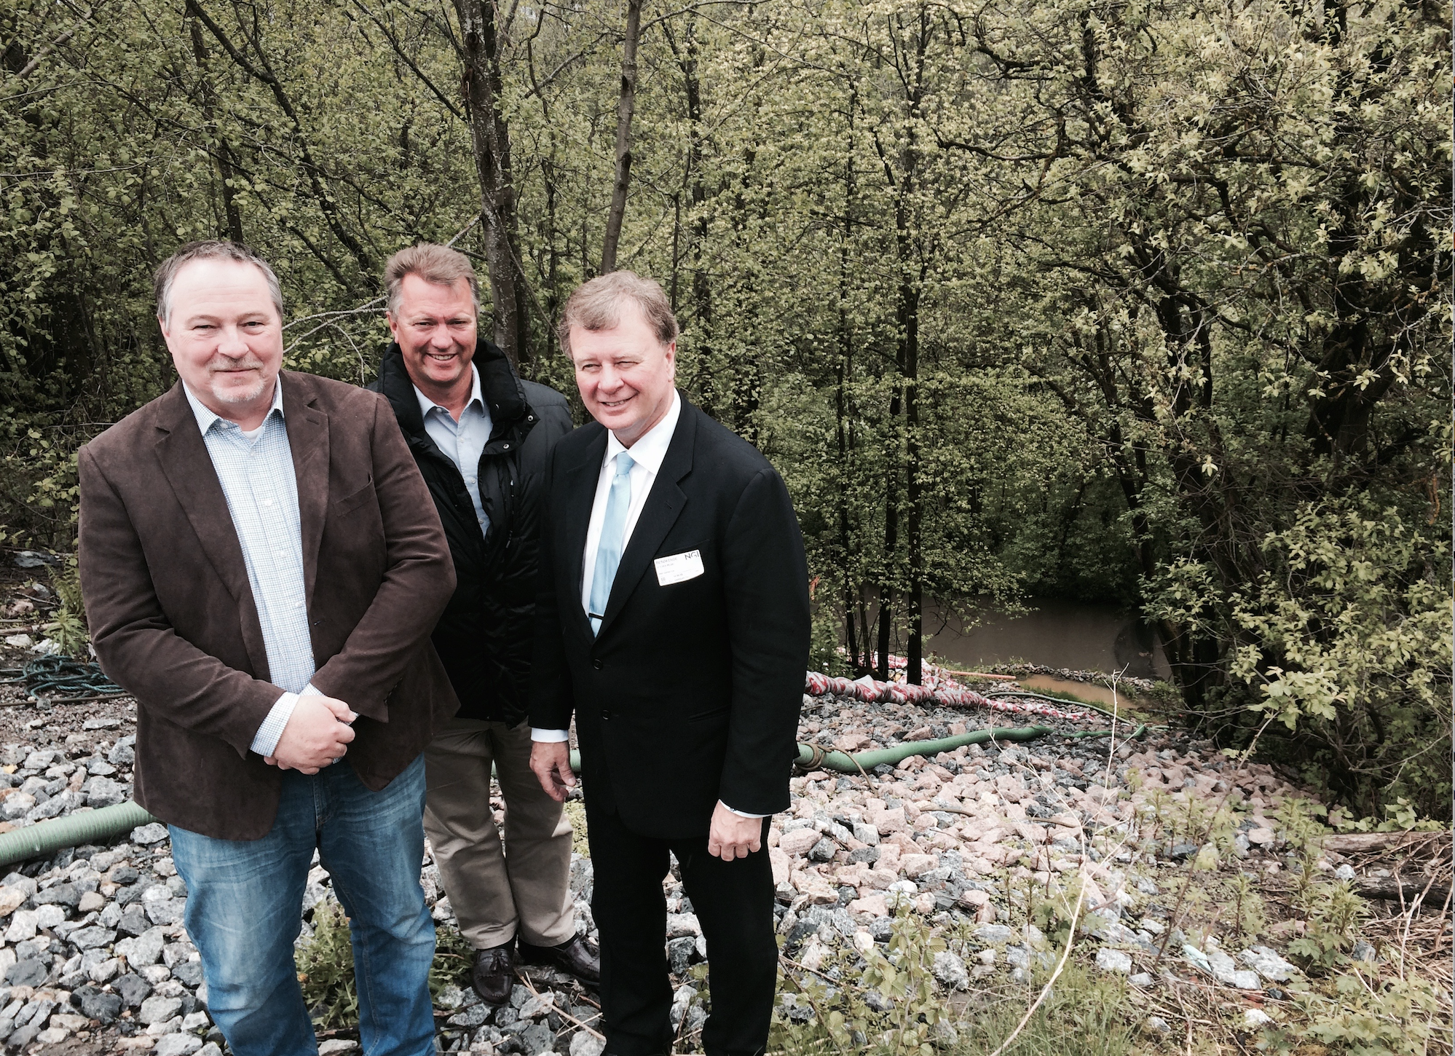
Oslo Norway Volvo Service Center Waste Oil Underground Clean Up With Oil Spill Eater II ( OSE II )
The CEO of the OSEI Corporation arrived in Oslo to see the Volvo Clean Up set up and discuss the project.
Christian, Karl part of the Norway distributorship team showing Steven Pedigo the set up on the river side of the project.

Slide 7
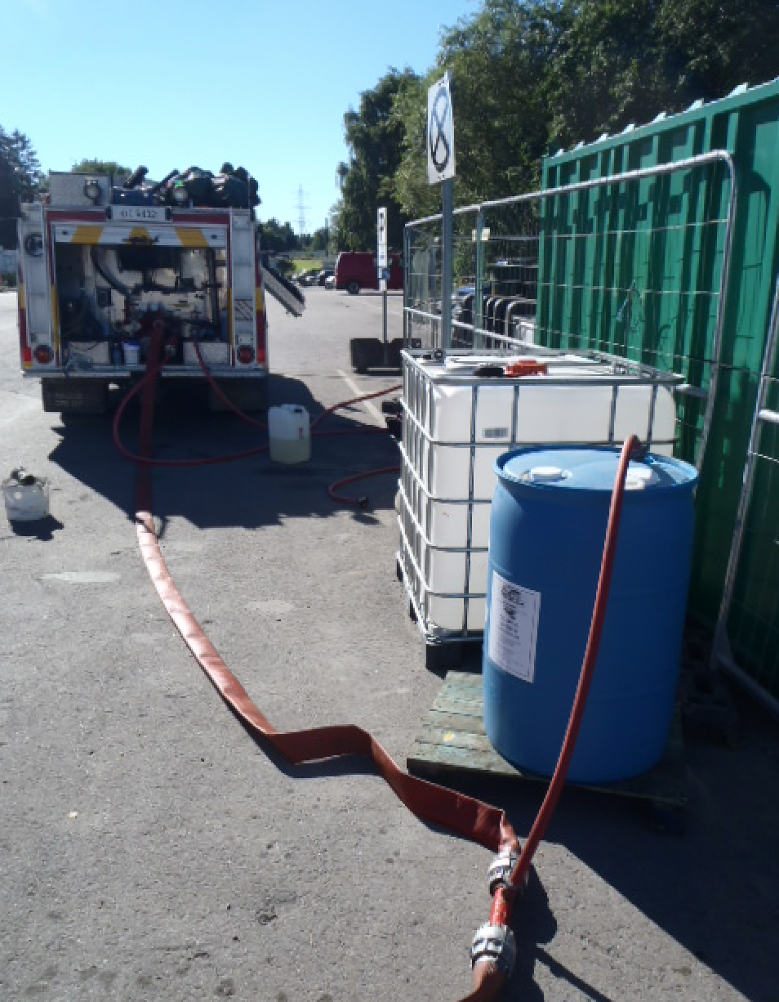
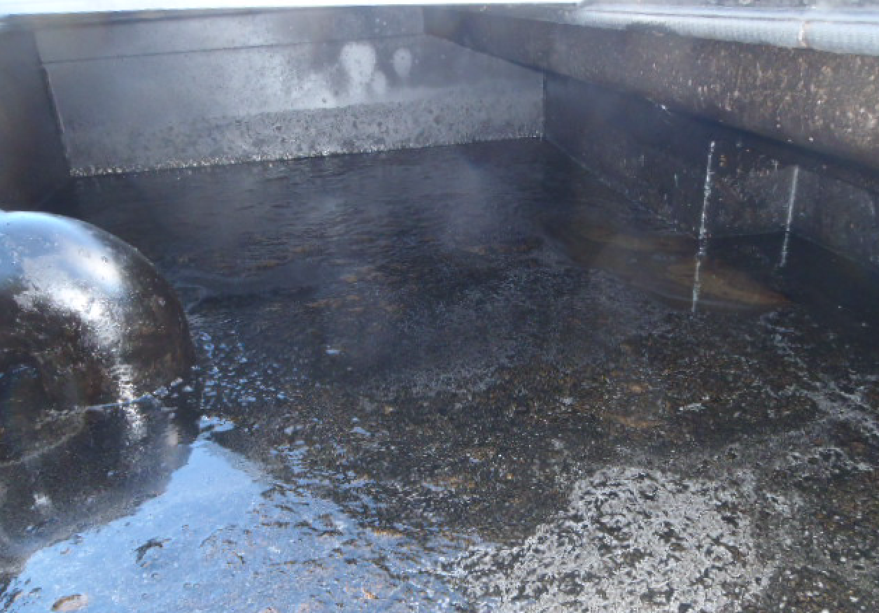
The Fire truck had natural water in its tank, where you can see the water feeder hose, which has another hose pulling OSE II from the Blue drum, where the water and OSE II were mixed at a ratio of 50 to 1, which was injected into the injection holes.
Once OSE II started reducing the adhesion properties of the oil and causing it to lift, allot of oil started being pulled into the metal container, where the oil volume could be monitored

Slide 8
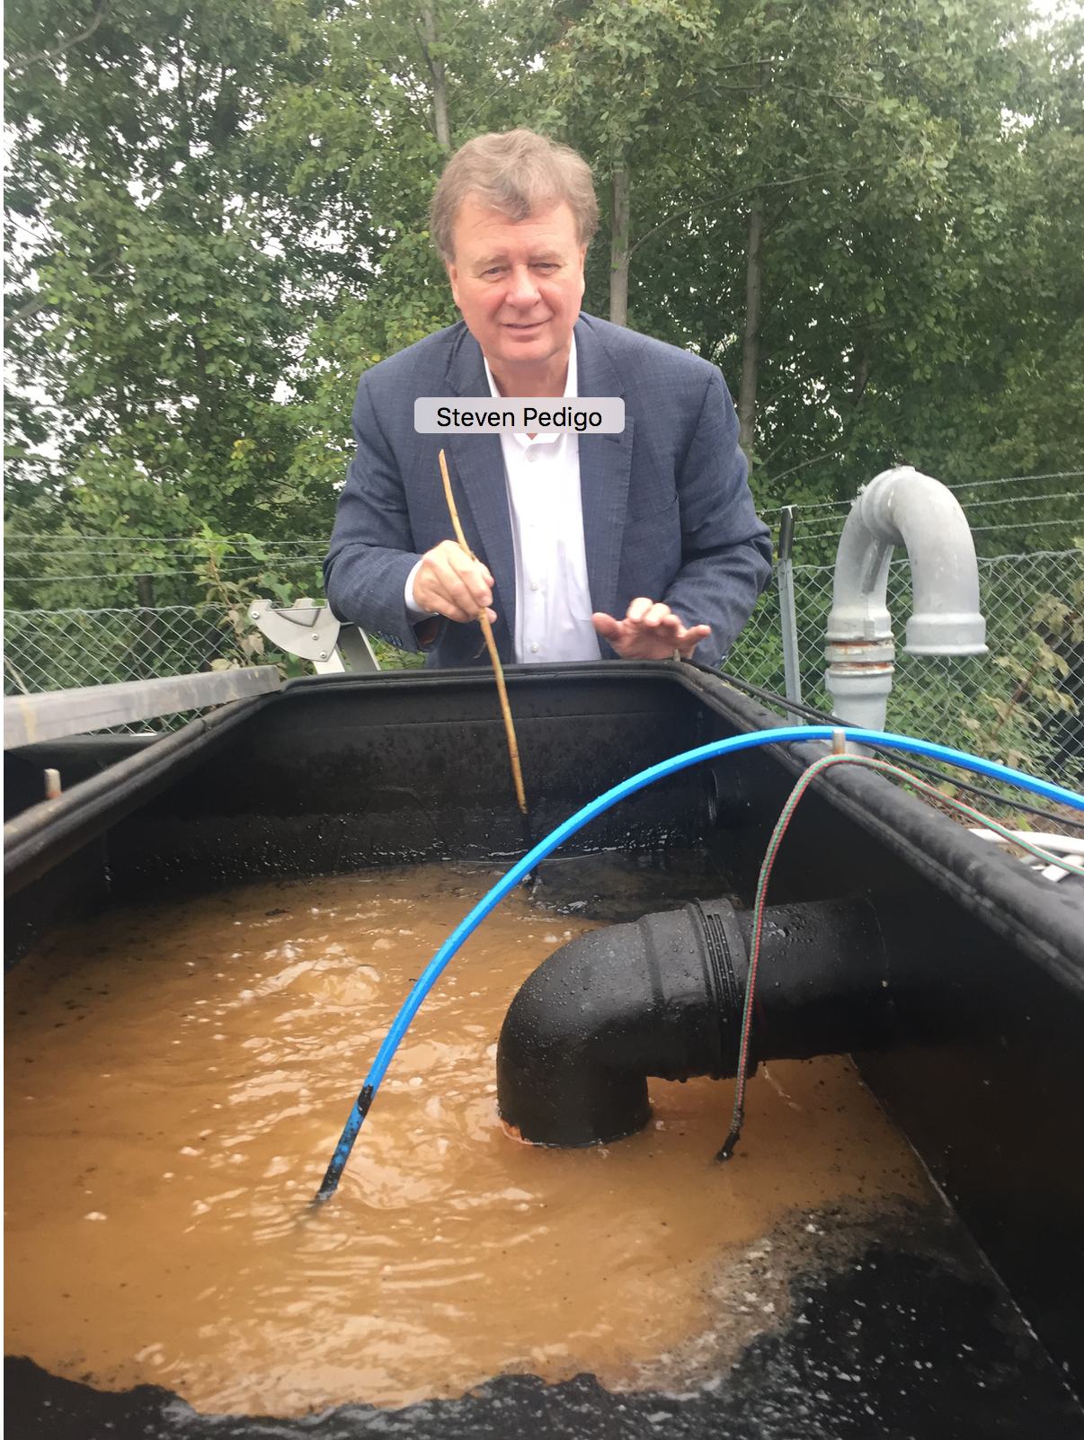
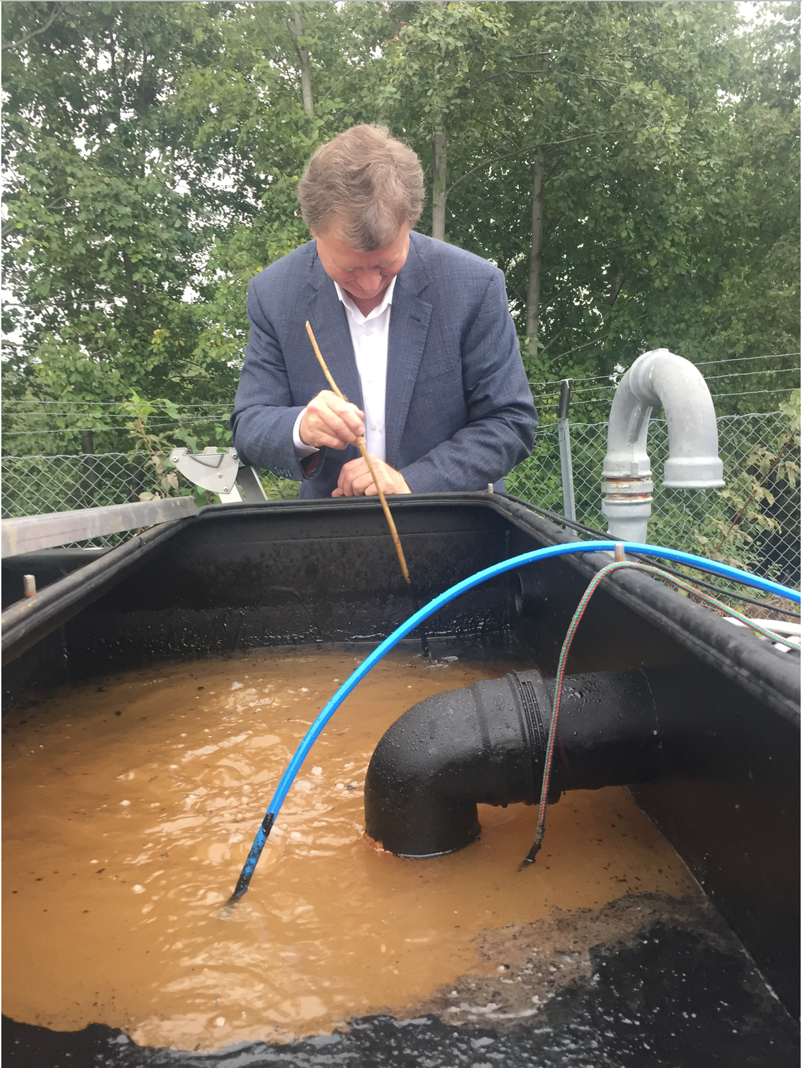
It had become apparent there had been more oil collected from under the soil leading to the creek from the Volvo oil tanks than calculated for, and while the OSE II was breaking down the oil and remediating it, there was not enough OSE II to handle the extra oil, therefor additional OSE II was applied.
The CEO of the OSEI Corporation stopping off a second time in Oslo to view the Volvo site and offering advice to complete the project.
P3. Norway, Oslo Volvo Truck Center Clean Up With OSE II
9

Slide 9
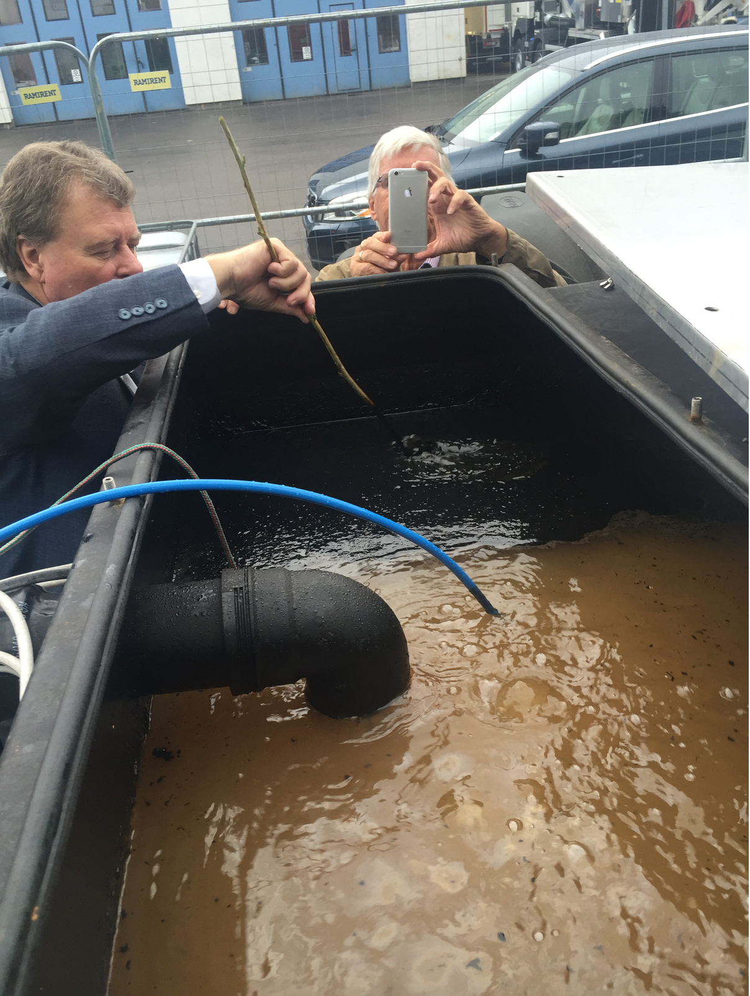
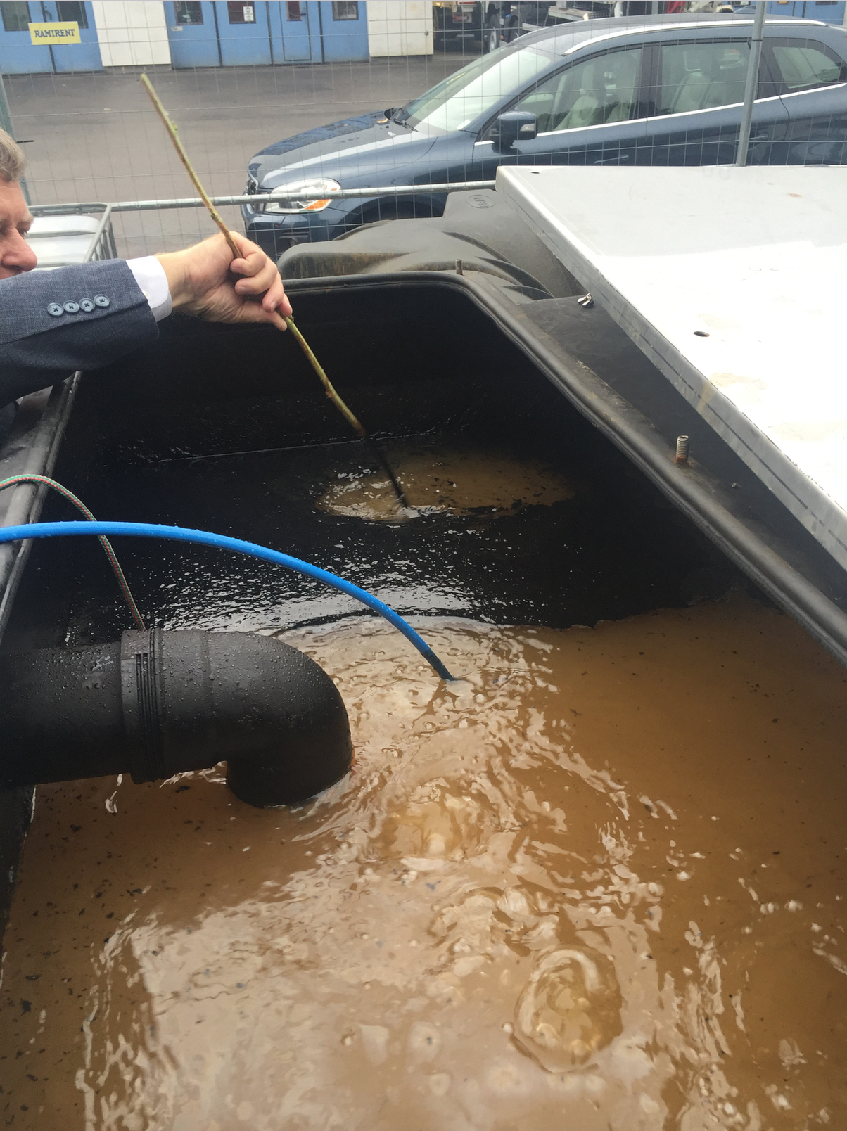
Before applying the additional OSE II, Mr. Pedigo stirred the oil to show nothing would happen.
The additional OSE II was applied and when you stirred the oil it showed the oil breaking down and becoming so fine it was leaving the surface clear of oil
The pump and treat system, with oil water separator, was collecting a very small amount of oil a month, once OSE II was applied to travel to the creek, the oil was broken down and its adhesion properties were diminished. Once the adhesion properties of the oil was reduced the oil was sucked from the underground area, and the oil was remediated in the metal container with nothing to haul off. OSE II stopped the oil from migrating to the river, and creating a sheen. OSE II was also used to clean up the shoreline and any freeze phase oil on the water. Once all the oil was collected additional OSE II was applied to make sure all the oil had been removed, and final sampling showed the site meeting Norway clean-up standards.
10

Slide 10
OSLO Norway Volvo Truck Center Clean Up With OSE II
The OSEI Corporation has reviewed the documents sent to us for the potential amounts of oil released, and collected or recovered. Our calculations show that approximately 180,000 liters of oil remains in the ground as potential leachate. See below calculations as to how much OSE II and water would be required to clean up this site.
Amount of contaminant
180,000 liters divided by 3.78 to convert to gallons equals 47619.05 gallons of hydrocarbon based contaminant.
Amount of OSE II in liters or gallons
Utilizing the 50 to 1 ratio you divide the number of gallons of contaminant by 50 therefor 47619.05 divided by 50 equals 952 gallons OSE II required.
Amount of OSE II in 208 liter or 55 gallon drums
To determine the number of 208 Liter/55 gallon drums you divide 952 by 55 and this equals divided by 55 equals 17.316 drums of OSE II required.

Slide 11
Application time
The application of these drums should be carried out as fast as possible to get all the OSE II and water applied so the OSE II and water mixture will not be overwhelmed by the volume of oil.
Amount of water required to mix with OSE II
952 gallons or 3598.56 liters of OSE II should be mixed with 50 gallons or 50 liters of fresh unpolluted water collected up stream from the Volvo site. You will need 179928 liters of water to mix with the 3598.56 liters of OSE II, or 47600 gallons of fresh unpolluted water collected up stream from the Volvo site.
Application volume per well
There were 5 wells drilled, these wells can be used to apply OSE II and water mixture. 3/4 of the OSE II and water mixture should be applied to the three interior wells, and the last ¼ fo the OSE II and water mixture should be applied to the 2 outside wells.
Post application Maintenance
The pumping system should remain on until you notice a difference in the effluent being pumped, at which time you would shut down the system until May 2017.

Slide 12
Site maintenance
Once a month 40,000 liters of fresh unpolluted water should be added to the system to insure O2 levels are remaining at a constant level and is not depleting, this should be carried out through August of 2017 or until testing has proven the contaminant levels have met acceptable levels.
Testing
Near the mid point of May 2017 test extractions should be taken to determine if the contaminant has reached acceptable levels, and the results need to be sent to the OSEI Corporation to see if any further additions of OSE II is required, or to see if a legal closure of the site can be obtained. The OSEI Corporation will add comments based on the contaminant levels determined in May 2017.
PGT
You will need to determine your costs, ( application adding water, monitoring) including testing to determine the end point of when the contaminant reaches acceptable levels.
This cost will need to be compared to the cost of pumping the site for the number of years it can be calculated to bring the contaminant to acceptable levels. This will be the comparative that we can discuss before, as well as how to submit a plan to Volvo/Insurance company.
Steven Pedigo.

Slide 13
Volvo Truck Center, Kjelsrud
Historikk og status for sanering av oljeforurensning.
Paul S. Cappelen, NGI
2016-11-16

Slide 14
Områdehistorikk
VTC ligger på en gammel avfallsfylling
Fylt med privat avfall ca. 1945
–1970-tallet
Opprinnelig terreng er en gammel ravine
Mektighet av avfall opptil 20 m
Etter at avfallsdeponeringen opphørte, har ravinen blitt fylt opp
med overskuddsmasser / utgravningsmasser fra utbygging i Groruddalen og Oslo sentrum
VTC
-bygget etablert tidlig 1990-tallet

Slide 15
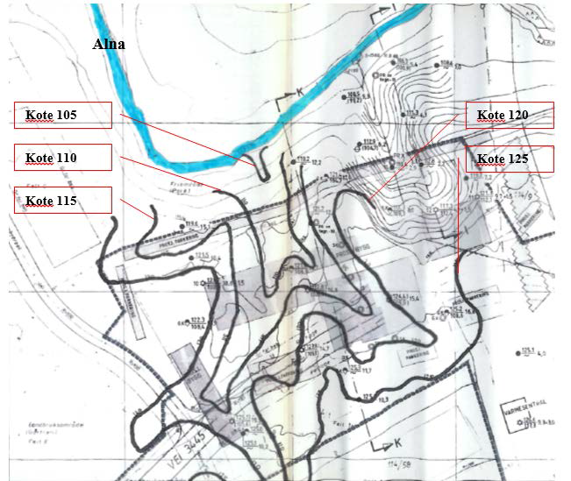
Terreng før fylling startet i 1945

Slide 16
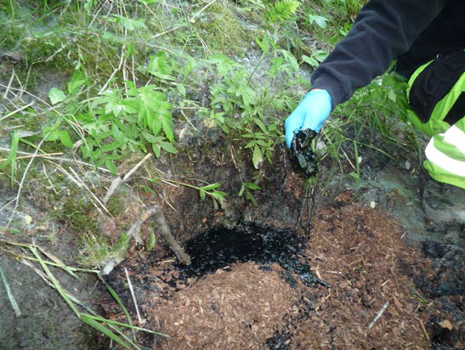
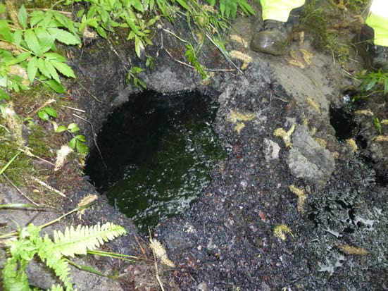
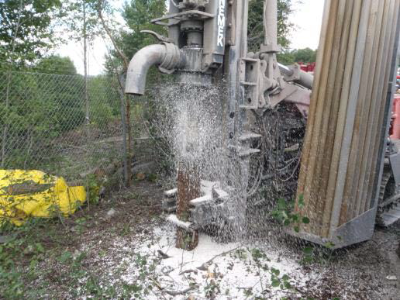

Slide 17
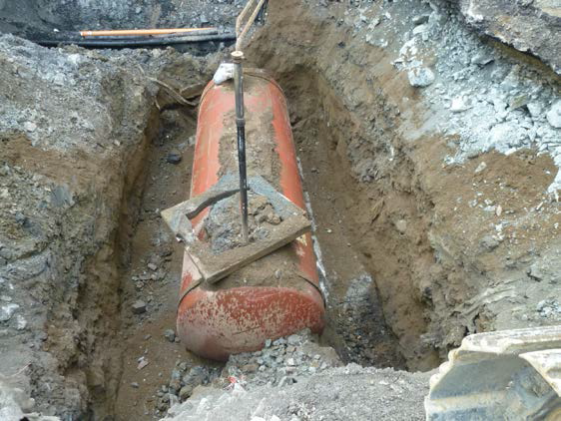
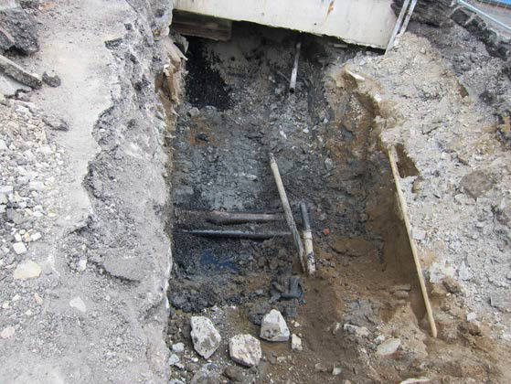
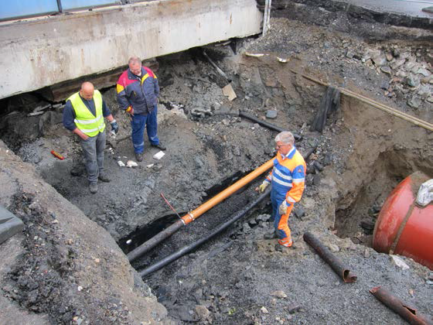

Slide 18
Akutte tiltak utført første år
Forurenset masse i rørgata langs bygget er fjernet og levert til godkjentmottak.
Fri fase olje og forurenset bark fra skråningen mot Alnaelva levert til godkjent mottak.
To oppsamlingsdammer med dykket utløp ble etablert i bunn av skråningen og
driftet fram til dags dato.
En tredje dam ble etablert som en ekstra sikring / buffer nedenfor de to dammene.
Lenser har hele tiden ligget ute i Alnaelva og kontrolleres fortløpende.
Det er fjernet oljeforurensning under bygg ved vasking og slamsuging.
Det er installert fem tiltaksbrønner på kanten av skråningen ned mot Alnaelva.
Slissede rør er satt ned utenfor port 39 og 34/35 for senere tiltak.

Slide 19
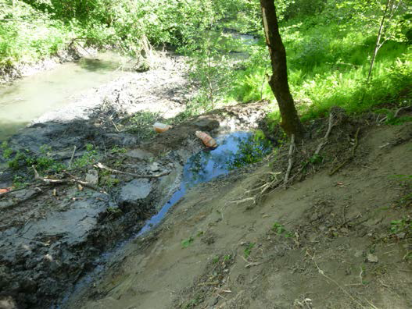
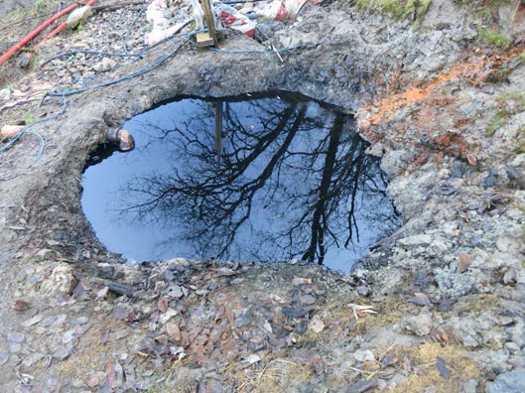
Flyfoto –oversikt

Slide 20
Pålegg fra Miljødirektoratet
Redegjøre for arealbruk og etablere miljømål for området.
Supplerende undersøkelser av forurensning.
Utarbeide tiltaksplander ett hovedtiltak anbefales.
Redegjøre for kontroll, overvåking og beredskap både før, under og etter tiltak.
Redegjøre for hvordan forurensning håndteres og hvordan tiltaksarbeidene dokumenteres og rapporteres.
Bruke godkjente saneringsmidler.
Gjennomføre tiltak og levere sluttrapport.
Tiltak som gjennomføres
Etablert system med pumper og oljeutskiller.
Vann tilføres i nedsatte, perforerte rør inne ved bygget. Vann og olje som kommer via grunnen pumpes så opp fra tiltaksbrønnene og via oljeutskiller. Her skilles oljen ut og vann tilbakeføres i grunnen ved bygget.
Da det etter hvert kom lite olje med denne metoden, ble det tilsatt
bioremedieringsmiddel, som gjør at oljen slipper lettere fra avfallsmassene i grunnen.
Oljen samles samtidig i dammene nede ved Alna og pumpes opp til
oljeutskiller og oppsamlingstank.
Underhele dette arbeidet beholdes lenser ute i Alnaelva.

Slide 22
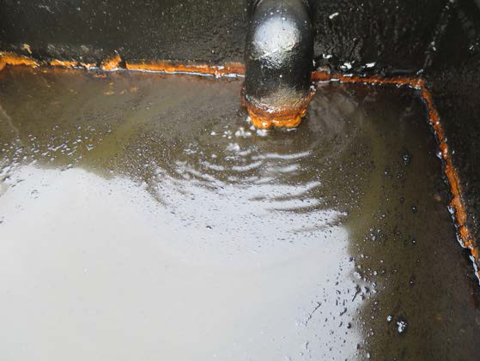
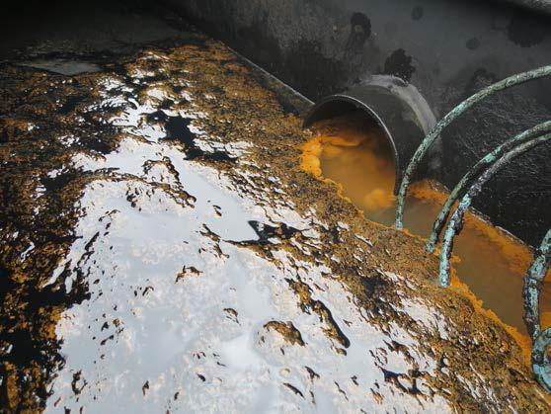
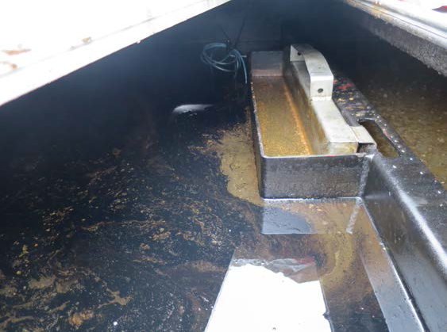

Slide 30
OIL SPILL EATER UNDERGROUND WASTE OIL REMEDIATION
OSE II in a couple of months accomplished more than the pump and treat system had in over 12 months. Once OSE II applied, OSE II caused the adhesion properties to reduce which released the oil from the soil, and OSE II also causes hydrocarbons to rise to the surface of soil which made it easy to pull the oil into the metal container where additional OSE II could be applied.
OSE II also detoxified the oil quickly allowing the indigenous bacteria in the river water to be sucked up into the fire truck and mixed with OSE II, to start utilizing the waste oil as a food source. OSE II also eliminates the flammability of oil/fuels as well, cleaned up the shoreline and the free phase oil on the water.
Once the indigenous bacteria started digesting the oil to a safe end point of CO2 it was just a matter of thirty to 60 days before the oil was remediated to CO2 and water, and permanently removed from the environment returning the site to pre spill conditions.
OSE II emulates mother nature except OSE II speeds natures own process up to remediate hydrocarbons or hydrocarbon based material to CO2 and water in a few days top weeks instead of decades, which would allow toxic hydrocarbons to linger in the environment. OSE II protecting the environment for over 60,000 times.

